Slide 1


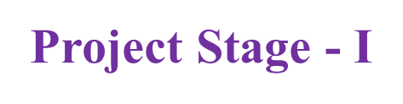
Project Title: AI- Lend Sense: Predictive and Explainable loan Decision System.
Presented By:​
Batch No: 2
1 . H. No: 227R1A05E4 Name: G. Bhavya Bhargavi
2 . H. No: 227R1A05D4 Name: B. Deepthi
3 . H. No: 227R1A05D2 Name: B. Balaji Nayak
​
.
Project Supervisor:​
Name:​ Dr. K. Srujan Raju
Designation: Professor

Slide 2
Index
Abstract
Introduction
Literature survey
Problem Definition
Proposed System
Objectives
Methodology
Analysis
Expected Outcomes

Slide 3
Abstract (Overview)
This project aims to automate loan approval decisions using AI and Machine Learning for faster, more consistent, and data-driven outcomes.
It addresses two major issues: bias in data leading to unfair results, and lack of transparency in AI decisions.
Models like Logistic Regression, Decision Tree, and Random Forest are trained on past loan data, with Explainable AI tools like LIME providing clear reasons for acceptance or rejection.
The system enhances fairness, transparency, and efficiency, helping both banks and applicants understand and trust the decision-making process.

Slide 4
Abstract (Contribution)
Developed an AI-based loan approval system that ensures fair and unbiased decisions by using high-quality, representative datasets.
Integrated Explainable AI (LIME) to clearly present reasons for loan approval or rejection, improving transparency and trust.
Provided applicants with actionable feedback on rejection reasons to help them improve future eligibility.
Enhanced decision-making speed and consistency compared to traditional manual loan assessment methods.

Slide 5
Introduction (Background)
Loan approval is a key process in banks, traditionally handled by officers who evaluate factors like income, job details, and credit score, but manual review can be slow and prone to bias.
Artificial Intelligence (AI) and Machine Learning (ML) can speed up decisions, improve accuracy, and reduce human errors by analyzing past loan data to identify approval patterns.
This project addresses two challenges — eliminating bias in decision-making and providing clear explanations for approvals or rejections to improve fairness and transparency.
Using tools like LIME, the system will offer applicants quick, understandable reasons for loan outcomes, helping them improve eligibility for future applications.

Slide 6
Introduction (Project Direction)
This project aims to build an AI-powered loan approval system that predicts acceptance or rejection based on applicant data such as income, job, and credit score.
It addresses two major issues: removing bias in decision-making to ensure fairness, and providing clear, understandable reasons for approvals or rejections.
Explainable AI tools like LIME are used to show applicants why a decision was made, increasing transparency and trust.
The goal is to make the loan approval process faster, fairer, and more reliable for both banks and customers.

Slide 7
Literature Review
Khandani, Kim & Lo — Consumer Credit-Risk Models via Machine-Learning Algorithms — 2010. Showed that nonparametric ML methods (trees, SVMs, ensembles) trained on large transaction + bureau datasets outperform classical linear models for predicting delinquencies and defaults; a key early demonstration that ML materially improves loan/credit prediction.
Bellotti & Crook — Support Vector Machines for Credit Scoring and Discovery of Significant Features — 2009. Applied SVMs to credit/credit-card default classification and compared them with logistic regression / LDA / k-NN, highlighting SVM strengths on real credit datasets and methods to find important features for interpretability.
Trustorff, Konrad & Leker — Credit Risk Prediction Using Support Vector Machines — 2011. Empirical study comparing LS-SVM and logistic regression on accounting/financial data for default prediction; discusses effects of training-sample size and probability estimation for credit scoring.

Slide 8
Literature Review
Brown & Mues — An experimental comparison of classification algorithms for imbalanced credit scoring data sets — 2012. Systematic comparison of many classifiers (incl. tree ensembles and sampling/imbalance remedies) on multiple credit datasets; important for handling class imbalance which is central to loan-default prediction.
Lessmann, Baesens, Seow & Thomas — Benchmarking state-of-the-art classification algorithms for credit scoring: an update of research — 2015. Large benchmarking update (follow-up to Baesens et al.) ranking modern algorithms for credit scoring, providing principled evaluation metrics and showing ensemble methods (boosting / RF) usually lead.
Zięba, Tomczak & Tomczak — Ensemble boosted trees with synthetic features generation in application to bankruptcy prediction — 2016. Proposed an XGBoost-style ensemble with synthetic feature generation for bankruptcy (closely related to credit default) and demonstrated notable gains versus baseline models on real datasets.

Slide 9
Proposed System
This project is an AI-powered loan approval framework enhanced with fairness-aware preprocessing and explainable decision-making techniques.
Key Features:
Bias-Resistant Data Processing: Implements preprocessing methods to detect and reduce bias in applicant data, ensuring fair treatment across all demographic groups.
Multi-Model Prediction Pipeline: Uses Logistic Regression, Decision Tree, and Random Forest models to collaboratively predict loan approvals with higher accuracy.
Explainable AI Integration: Employs LIME to clearly present the factors influencing each approval or rejection decision.
Applicant Feedback System: Provides applicants with transparent and actionable reasons for rejection, enabling them to improve future applications.
Continuous Learning: Periodically retrains models with updated, unbiased data to maintain accuracy and fairness over time.

Slide 10
Problem Definition
Traditional loan approval processes in banks are time-consuming, involve manual evaluation, and can lead to inconsistencies or unfair decisions.
AI-based systems can speed up the process, but if trained on biased historical data, they may reproduce or amplify discrimination (e.g., against specific income groups or genders).
Many existing AI models lack transparency, making it unclear to applicants and banks why a loan was approved or rejected, which reduces trust in the system.
There is a need for a solution that ensures fairness, accuracy, and explainability while providing applicants with clear reasons for rejection or acceptance to help them improve future applications.

Slide 11
Objectives
Develop an AI-driven loan approval system capable of making faster, more consistent, and unbiased decisions.
Eliminate decision-making bias by using fair and representative data during model training.
Integrate Explainable AI tools (e.g., LIME) to provide clear and understandable reasons for loan acceptance or rejection.
Increase transparency and trust in the loan approval process for both customers and banks.
Help applicants understand the cause of rejection and guide them on improving future applications.
Ensure the system’s predictions are accurate, fair, and compliant with ethical AI practices.

Slide 12
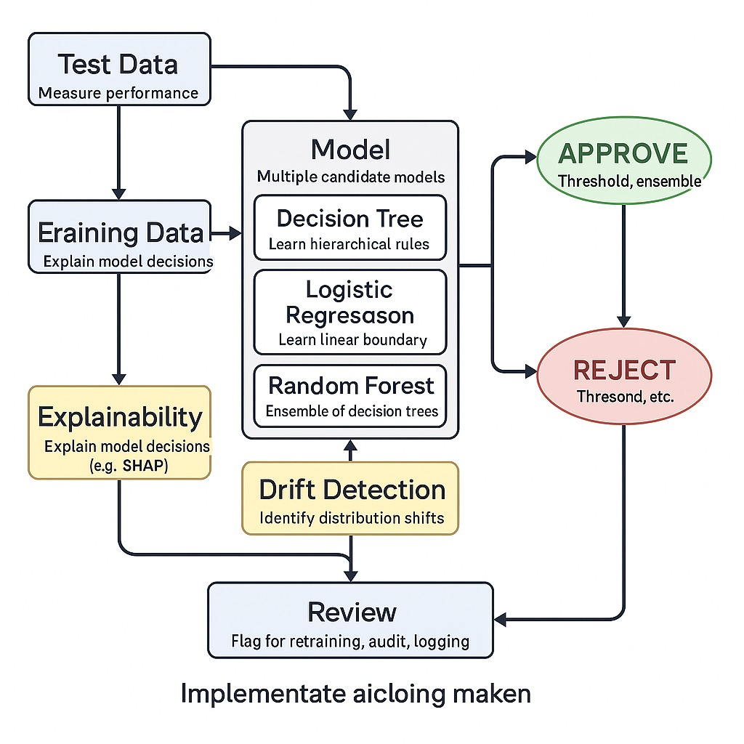
Methodology
.
Work Flow of Loan Prediction

Slide 13
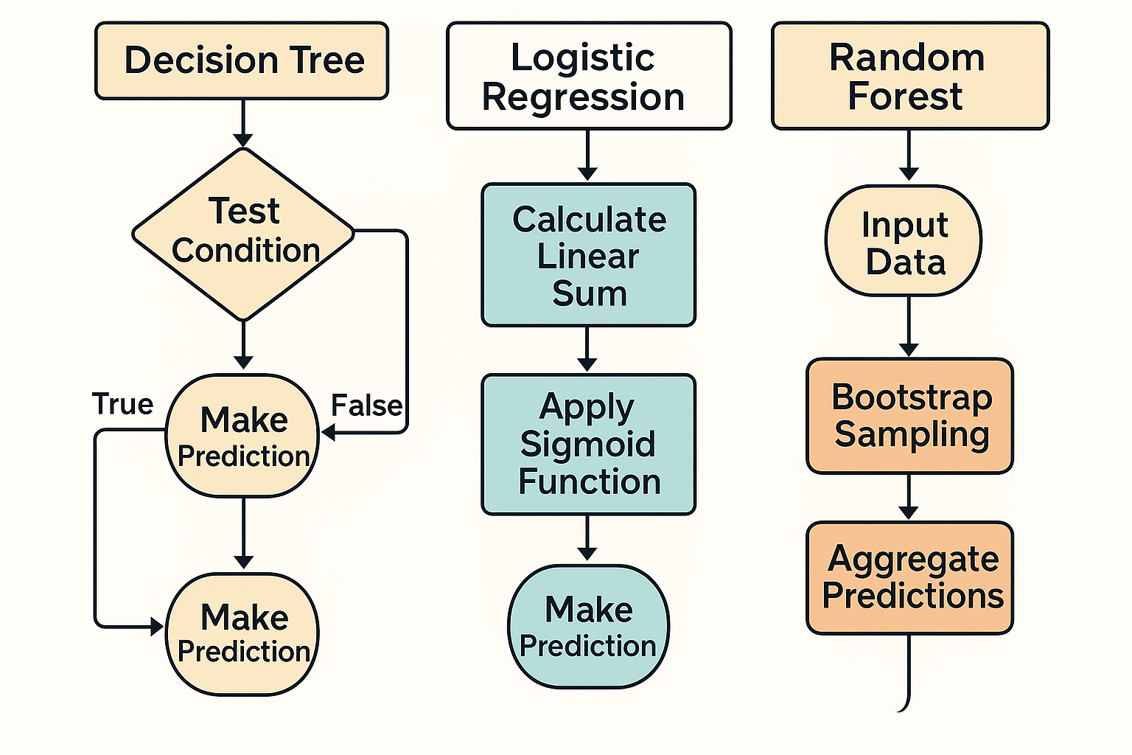
Methodology
Working of algorithms

Slide 14
Analysis
Bias Impact: Biased training data (e.g., against certain income groups or genders) can lead the AI model to replicate existing discrimination, reducing fairness and trust in the system.
Explainability Gap: Many AI models act as “black boxes,” failing to clearly explain why a loan was approved or rejected, which limits user understanding and bank transparency.
Role of Explainable AI: Using tools like LIME allows the system to identify and present key factors influencing the decision, making the outcome easier to justify to applicants.
Fair Decision-Making: Combining clean, unbiased datasets with explainable outputs helps maintain both accuracy and equity in loan approvals.
Process Transparency: Providing rejection reasons empowers applicants to address shortcomings and reapply, improving customer experience and trust.

Slide 15
Expected Outcomes
Improved Loan Approval Accuracy: Achieve higher prediction accuracy in determining loan eligibility using AI models (Logistic Regression, Decision Tree, Random Forest).
Faster Decision-Making: Reduce loan processing time by automating approval predictions through machine learning algorithms.
Fair and Transparent Evaluation: Provide explainable results using LIME, ensuring applicants understand reasons for approval or rejection.
Bias Reduction in Decisions: Minimize unfair treatment by training models on balanced and representative datasets.
Enhanced Customer Experience: Deliver instant feedback on loan applications, improving satisfaction and trust.

